Slide 1


Python Coding Session Pandas
Introduction to Implementation Details and Usage

Slide 2

Introduction
Pandas is open-source Python library designed for data manipulation and analysis. It provides data structures and functions that make it easier to work with structured data like tables, spreadsheets, and databases. The two primary data structures in Pandas are the Series and DataFrame.

Slide 3
Topics
Load and Exploring Data
Data Selection and Filtering
Grouping and Aggregation
Data Cleaning
Merging and Joining Data
Reshaping data
Time Series Operations

Slide 4
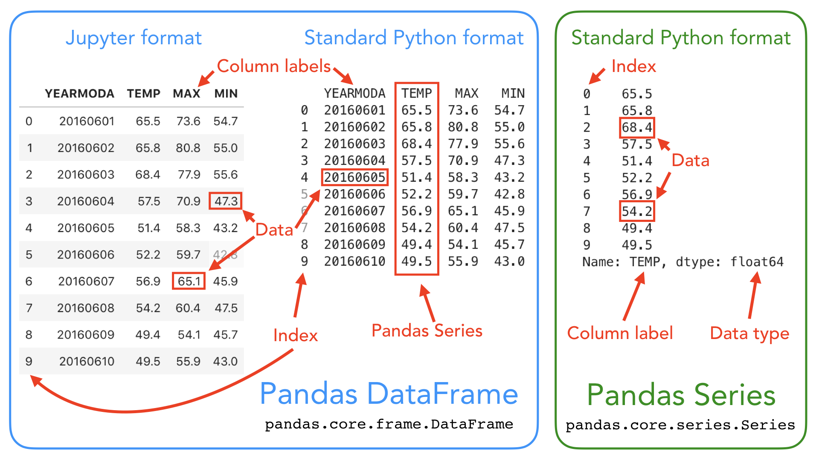
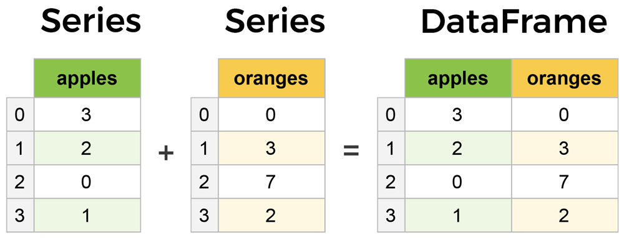
How Pandas work

Slide 5
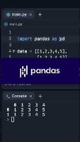

Slide 6
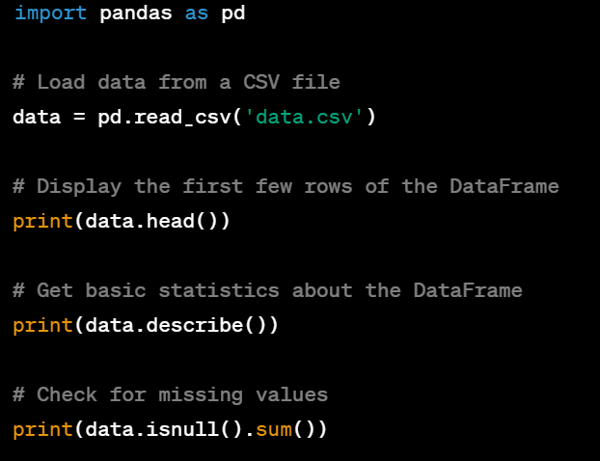
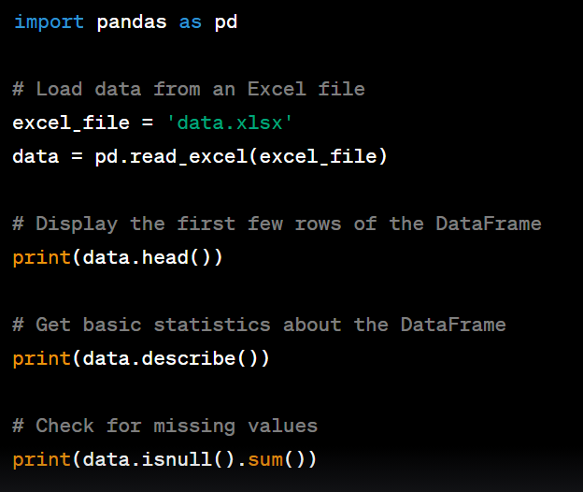
Introduction
Load and Exploring Data

Slide 7
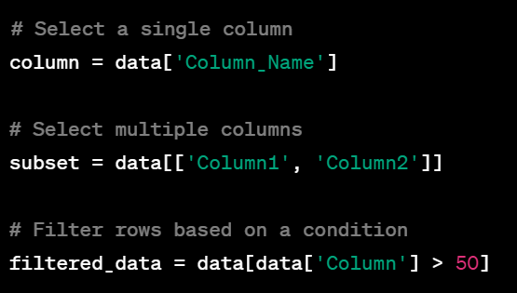
Introduction
Data Selection and Filtering

Slide 8
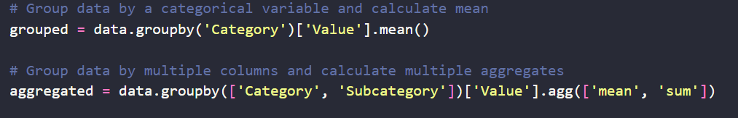
Introduction
Grouping and Aggregation:

Slide 9
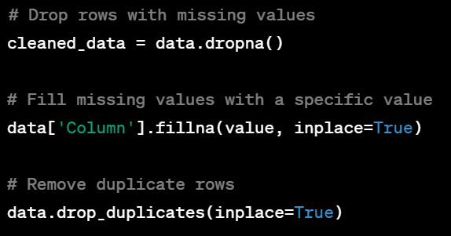
Operations with Numpy
Data Cleaning:

Slide 10
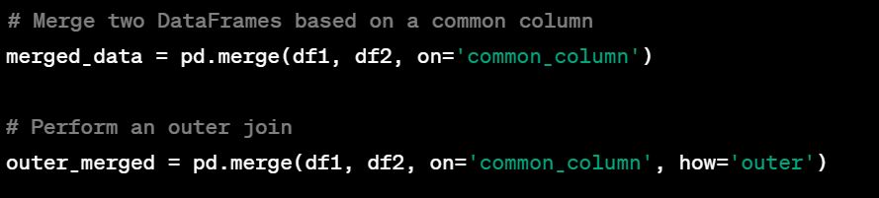
Operations with Numpy
Merging and Joining Data:

Slide 11
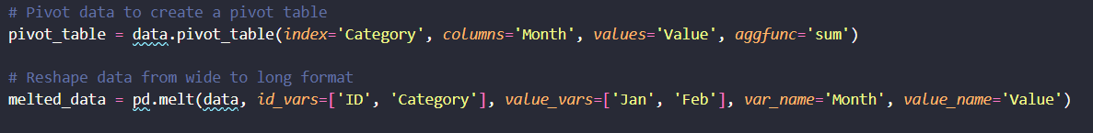
Example
Reshaping data:

Slide 12
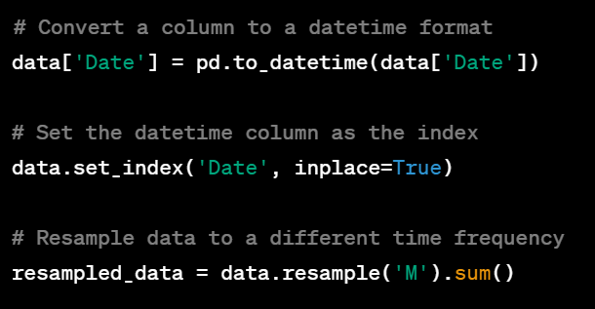
Example
Time Series Operations:

Slide 13
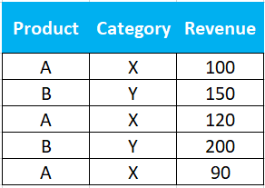
Exercises
Exercise 1: Creating a DataFrame
Task: Create a Pandas DataFrame containing information about fruits. The DataFrame should have two columns: "Fruit" and "Quantity". Populate it with the following data:
Apple: 5
Banana: 10
Cherry: 15
Exercise 2: Filtering Data
Task: Given a DataFrame containing information about students' grades, filter and display only the rows where the grade is greater than or equal to 90.
Exercise 3: Grouping and Aggregating Data
Task: Given a DataFrame containing sales data, calculate the total sales revenue for each product category.

